Slide 1


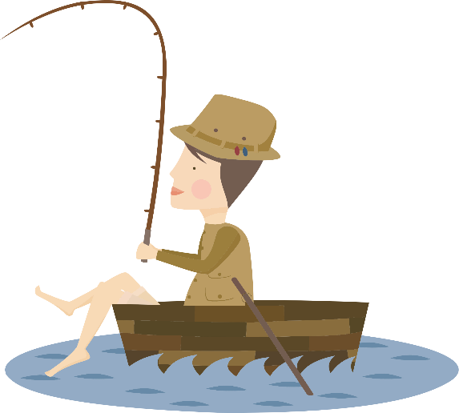



LET’S GO FISHING!
Role Play Game
Notes:
Outline slide

Slide 2

Game Set Up – Round 1
Place your map of the Northern Ireland coastline in the centre of your group
Set up your map as follows…
Notes:
Outline slide

Slide 3
Who are you?
You are a fisherperson!
You own a large fishing boat
You catch fish and sell them to the fishmonger at a reasonable price
You sell the fish you catch to make money required for boat repairs and living costs
Notes:
You need enough money to buy fuel for your fishing boat, fishing gear and to make repairs

Slide 4
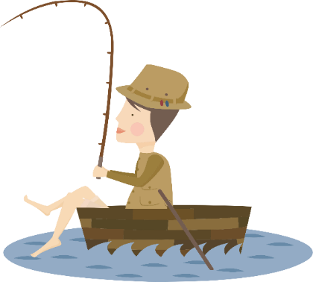


Your job?
CAREFUL!
These fish have different values
£
££
£££

Slide 5

Who am I?
I am the Fisheries Scientist!
My job is to make sure that everybody gets enough fish while leaving sufficient adult fish in the sea to produce the baby fish needed for the future
I put rules in place that limit the number of fish fisherpersons can catch each year – These rules are called Fishing Limits
Notes:
You need enough money to buy fuel for your fishing boat, fishing gear and to make repairs

Slide 6
CATCH YOUR FISH!!!
Year 1

Slide 7
Year 1
Q. How much money did you make?
Q. Who earned the most money?

Slide 8
Year 2
CATCH YOUR FISH!!!

Slide 9
Year 2
Q. How much money did you make?
Q. What has happened?

Slide 10
Overfishing
Overfishing is catching too many fish at once, so the breeding population becomes to small to recover.
Is a serious threat to our oceans, taking a greatest toll on sea life, and people.

Slide 11

Game Set Up – Round 2
Set up your map as follows…
Sharks are spread throughout the sea
Skates are together in 1 area
Notes:
Outline slide

Slide 12

FISHING LIMITS
Each fisherperson is allowed 2 fish only
For every 2 fish, you also catch 1 shark or 1 skate
=
=
OR

Slide 13

CATCH YOUR FISH!!!
Round 2

Slide 14
Round 2
Q. How much money did you make?
Q. Did the fishing limits stop you from overfishing?
Q. As a fisherperson are you happy about this?
Q. What happened to the sharks & skates?

Slide 15
Bycatch
Bycatch is the fish that are caught unintentionally while catching other fish.
It includes fish that are the wrong size (too small), and other species that are banned or endangered species.
It is caused by extremely efficient but indiscriminate fishing gear

Slide 16
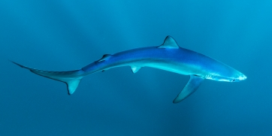
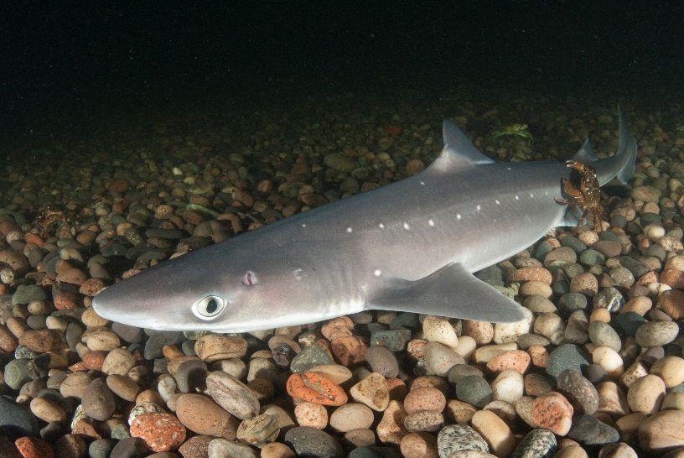
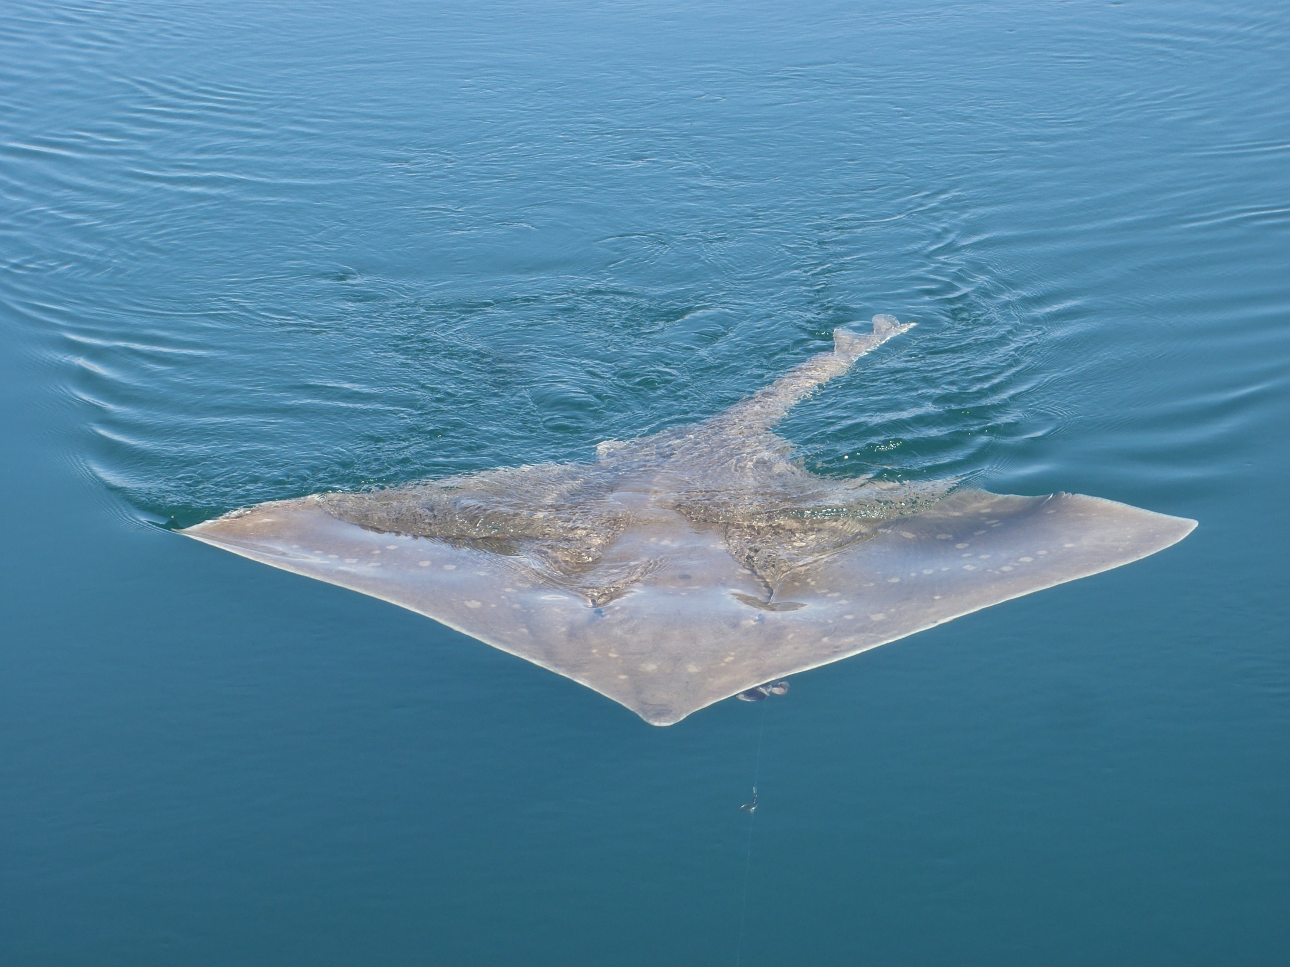
Does it matter if
we fish all the
sharks and rays?

Slide 17
What can we do to protect sharks, skates and rays?

Slide 18
Game Set Up - Round 3
Set up your board for round 3!

Slide 19


Make a ‘Safe Zone’ for your sharks AND/OR skates
You cannot move the position of the sharks or skates!
Round 3 Rules
Your limit = 2 fish each!
For every 2 fish, take 1 shark OR skate
You cannot fish in the Safe Zone
=
OR
=

Slide 20
CATCH YOUR FISH!!!
Round 3

Slide 21
Round 3
Q. Did the safe zone help protect the sharks?
Q. Did the safe zone help to protect the skates?
Q. Will you be able to fish next year?

Slide 22


Sharks are mobile.
This makes it more difficult to protect them.
Skates have a ‘home’.
This is called site fidelity.
Safe zones or Marine Protected Areas can be effective protection for species that live in one area.

Slide 23
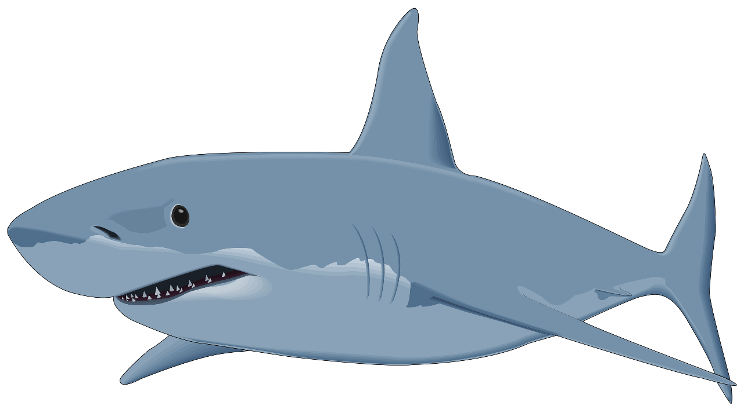
Group Activity – Take Action!
What can you do as individuals and in groups to help protect sharks, skates and rays?
Notes:
Activity – ID circus

