Slide 1
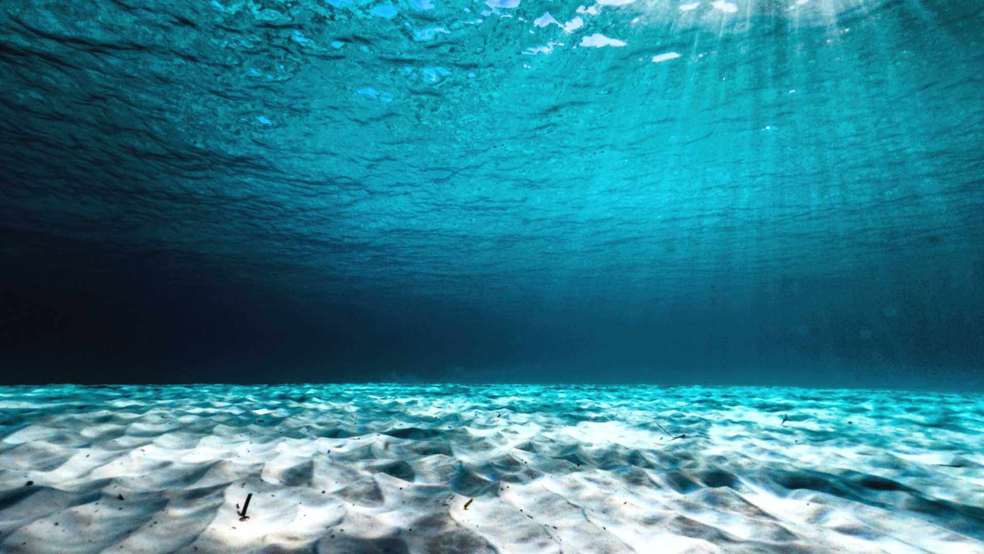
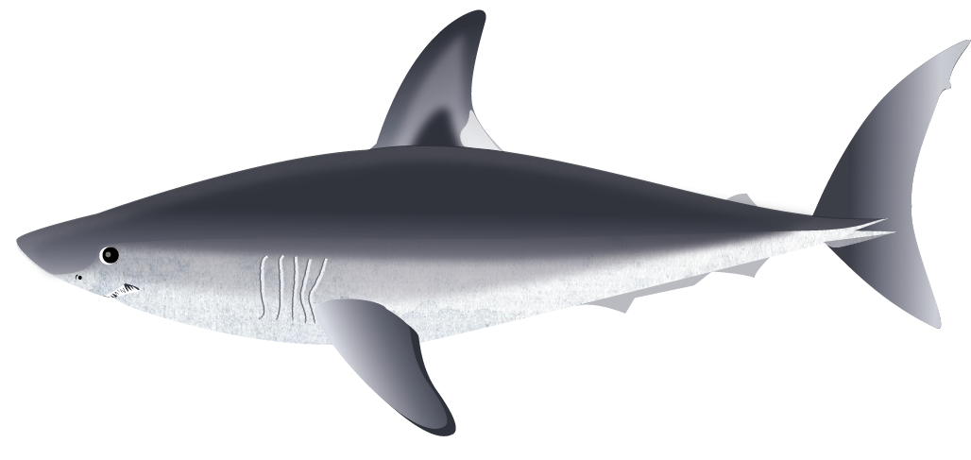
Shark Conservation Quiz
Play Quiz!

Slide 2
1. What are the 2 main ways to protect shark populations to give them a chance to recover?
MPAs and overfishing
Fisheries management and pollution
MPAs and fisheries management
www.seadeepni.org @seadeepni

Slide 3
Oops… That’s wrong
MPAs are one way to protect shark populations but overfishing is harmful to sharks and can cause their numbers to decline!
Try again
www.seadeepni.org @seadeepni

Slide 4
Oops… That’s wrong
Fisheries management is one way to help protect shark populations, but pollution has a negative impact on sharks!
Try again
www.seadeepni.org @seadeepni

Slide 5
Yes! That’s correct
Marine Protect Areas (MPAs) and fisheries regulations are the 2 main ways to protect shark populations to give them a chance to recover!
Next question
www.seadeepni.org @seadeepni

Slide 6
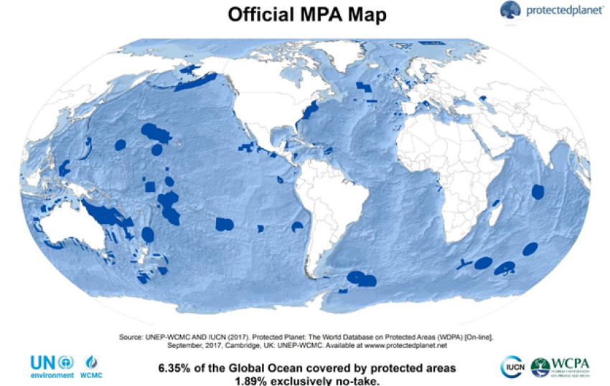
2. What is a Marine Protect Area (MPA)?
A form of special protection for an area where rules are put in place to protect a species
The number of species and bycatch you can land
www.seadeepni.org @seadeepni

Slide 7
Yes! That’s correct
An MPA is usually in a place that is important to the species such as a nursery area and regulations such as no fishing in the area are put in place here!
Next question
www.seadeepni.org @seadeepni

Slide 8
Oops… that’s wrong
This is fisheries management and sets other things as well such as mesh sizes and regulations on equipment. Fines can occur if these are not followed!
Next question
www.seadeepni.org @seadeepni

Slide 9
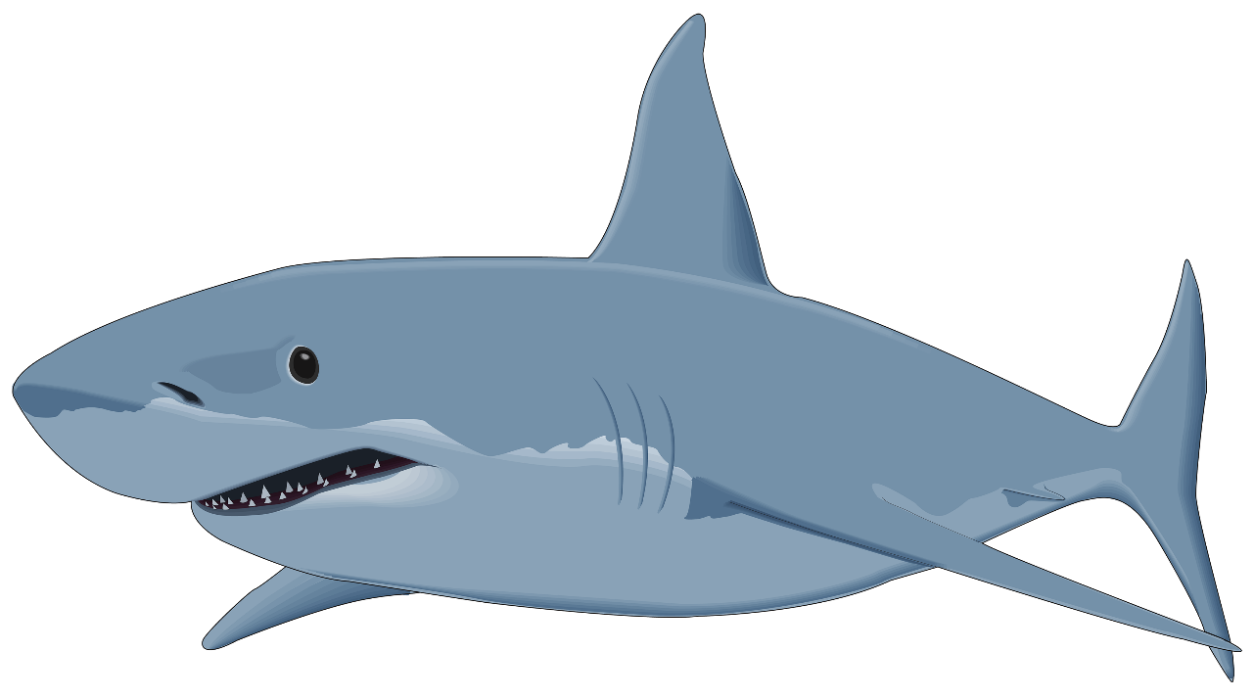
3. What data do we need to protect species?
Who is out there?
Where are they?
What are they doing?
All of the above
www.seadeepni.org @seadeepni

Slide 10
Oops… that’s wrong – Sort of!
We actually need to know who is out there, where they are and what they are doing in order to try and provide the best protection for a species!
Next question
www.seadeepni.org @seadeepni

Slide 11
Yes! That’s correct
We need to know who is out there, where they are and what they are doing in order to try and provide the best protection for a species!
Next question
www.seadeepni.org @seadeepni

Slide 12
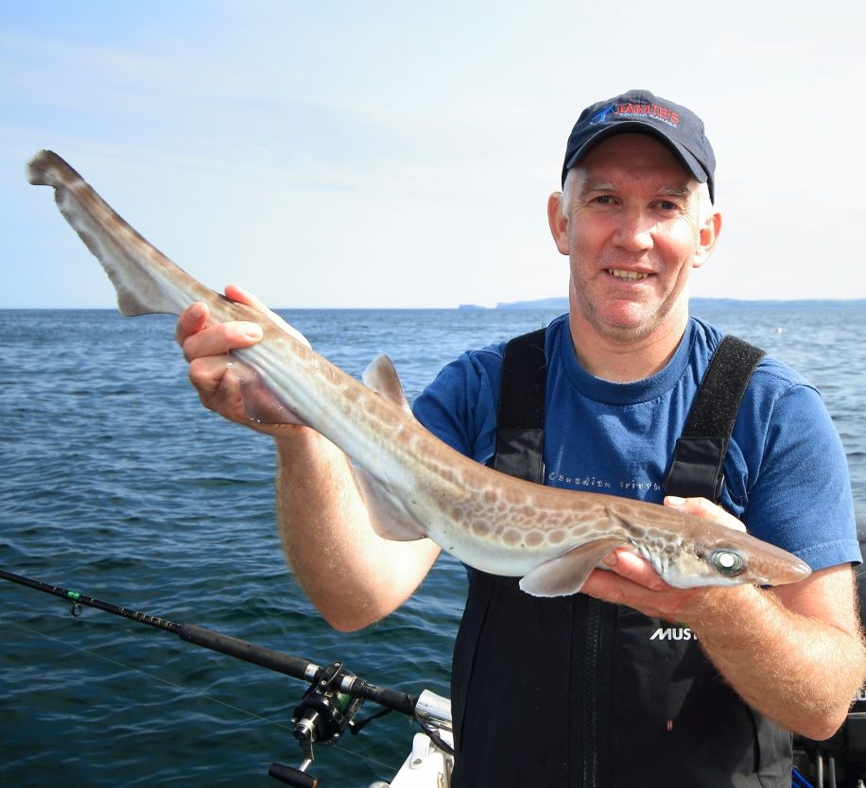
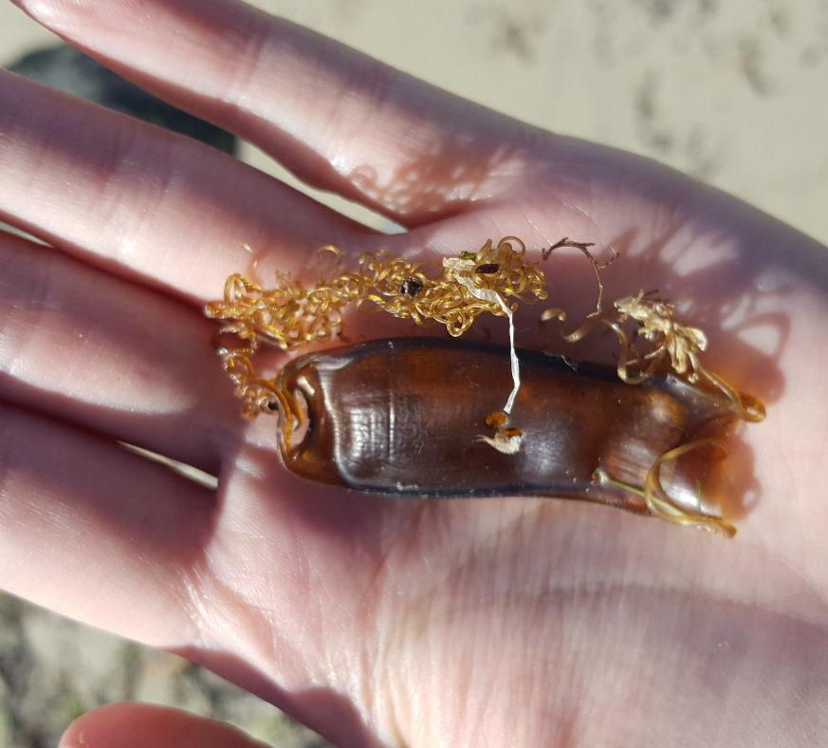
4. How does Sea Deep collect all of the information it needs?
Egg case surveys and angling
Angling and camera tagging
Camera tagging and egg case surveys
www.seadeepni.org @seadeepni

Slide 13
Yes! That’s correct
Sea Deep get all the data they need from both egg case surveys and tagging data from anglers!
Next question
www.seadeepni.org @seadeepni

Slide 14
Oops… that’s wrong
Although we do use data from angling, camera tagging is a very expensive process, so we rely on other methods to get the information we need!
Next question
www.seadeepni.org @seadeepni

Slide 15
Oops… that’s wrong
Although we do use data from egg case surveys, camera tagging is a very expensive process, so we rely on other methods to get the information we need!
Next question
www.seadeepni.org @seadeepni

Slide 16
5. What are the pros of angling as a way to get data?
Recaptures are possible
It involves people
You get precise data
All of the above
www.seadeepni.org @seadeepni

Slide 17
Oops… that’s wrong – Sort of!
Angling is a great way collect precise data and it means that recaptures are possible. It is also a great way to involve people in shark conservation!
Next question
www.seadeepni.org @seadeepni

Slide 18
Yes! That’s correct
Angling is a great way collect precise data and it means that recaptures are possible. It is also a great way to involve people in shark conservation!
Next question
www.seadeepni.org @seadeepni

Slide 19
6. Anyone can go egg case hunting!
TRUE or FALSE
www.seadeepni.org @seadeepni

Slide 20
Yes! That’s correct
The great thing about egg case hunting is that anyone can do it! You can just head to the beach and upload any egg cases you find on the Sea Deep website!
Next question
www.seadeepni.org @seadeepni

Slide 21
Oops… that’s wrong – Sort of!
The great thing about egg case hunting is that anyone can do it! You can just head to the beach and upload any egg cases you find on the Sea Deep website!
Next question
www.seadeepni.org @seadeepni

Slide 22
7. What is the name of this part of an egg case?
Capsule
Keel
Horns
www.seadeepni.org @seadeepni

Slide 23
Yes! That’s correct
The centre part of the egg case is called the capsule!
End quiz
Capsule
www.seadeepni.org @seadeepni

Slide 24
Oops… that’s wrong
The keel is the area around the outside of the eggcase!
Try again
Keel
www.seadeepni.org @seadeepni

Slide 25
Oops… that’s wrong
The horns are the paired parts of the egg case that are on either end!
Try again
Horns
www.seadeepni.org @seadeepni

Slide 26
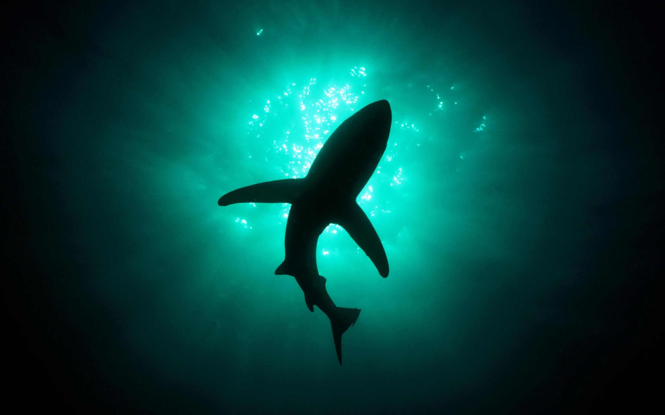
WELL DONE!
In Deep Water Quiz

