Slide 1
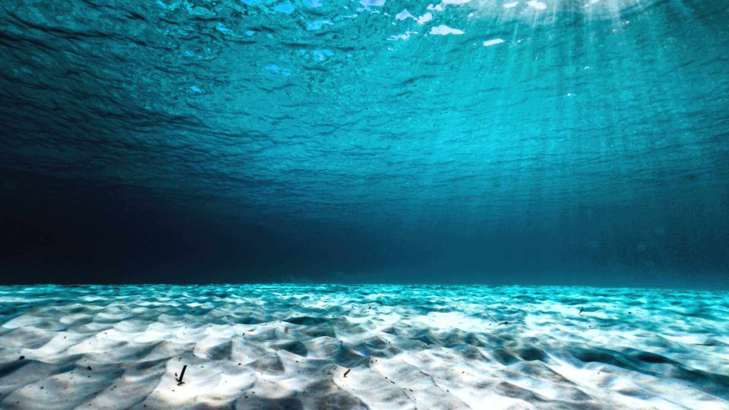
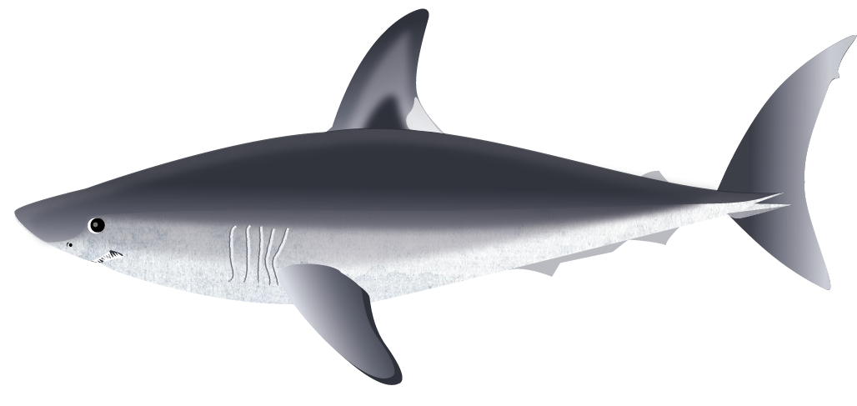
Shark Biodiversity Quiz
Let’s recap everything you learnt in lesson 2
Meet our local sharks!
Play Quiz!

Slide 2
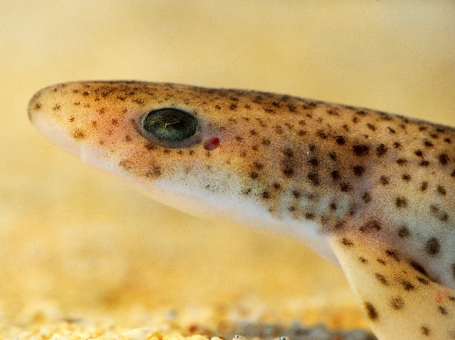
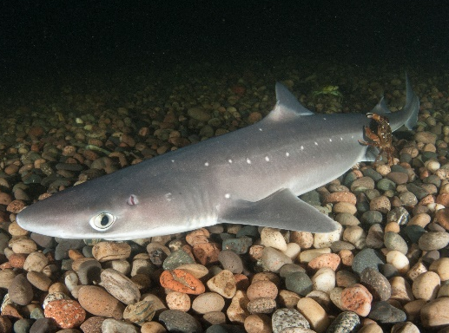
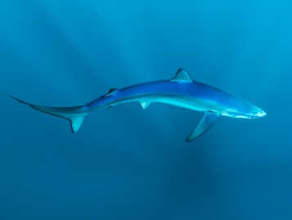
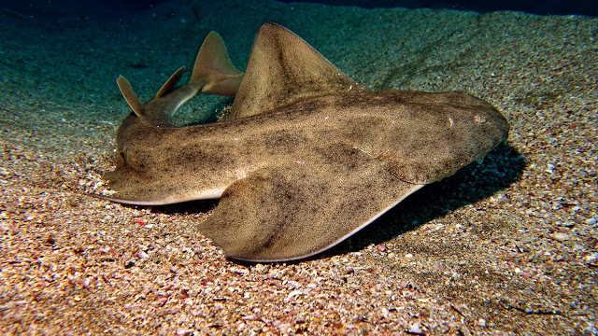
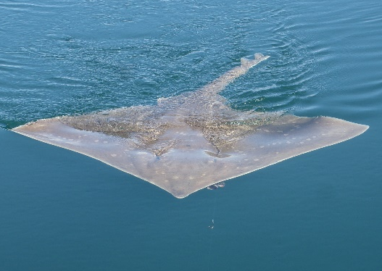
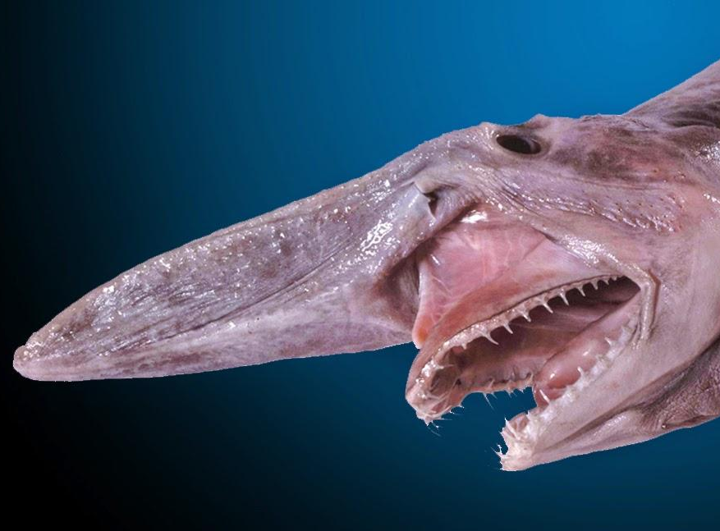
1
5
8
2nd biggest!
Our most common shark
Longest pregnancy
3
7
2
Found across the globe
Tail as long as its body!
Cousin of the Great White
9
6
4
Biggest skate in the world!
Slingshot feeding
Locally extinct?
Notes:
Local species recap

Slide 3
WELL DONE!
Shark Biodiversity Quiz

