Slide 1
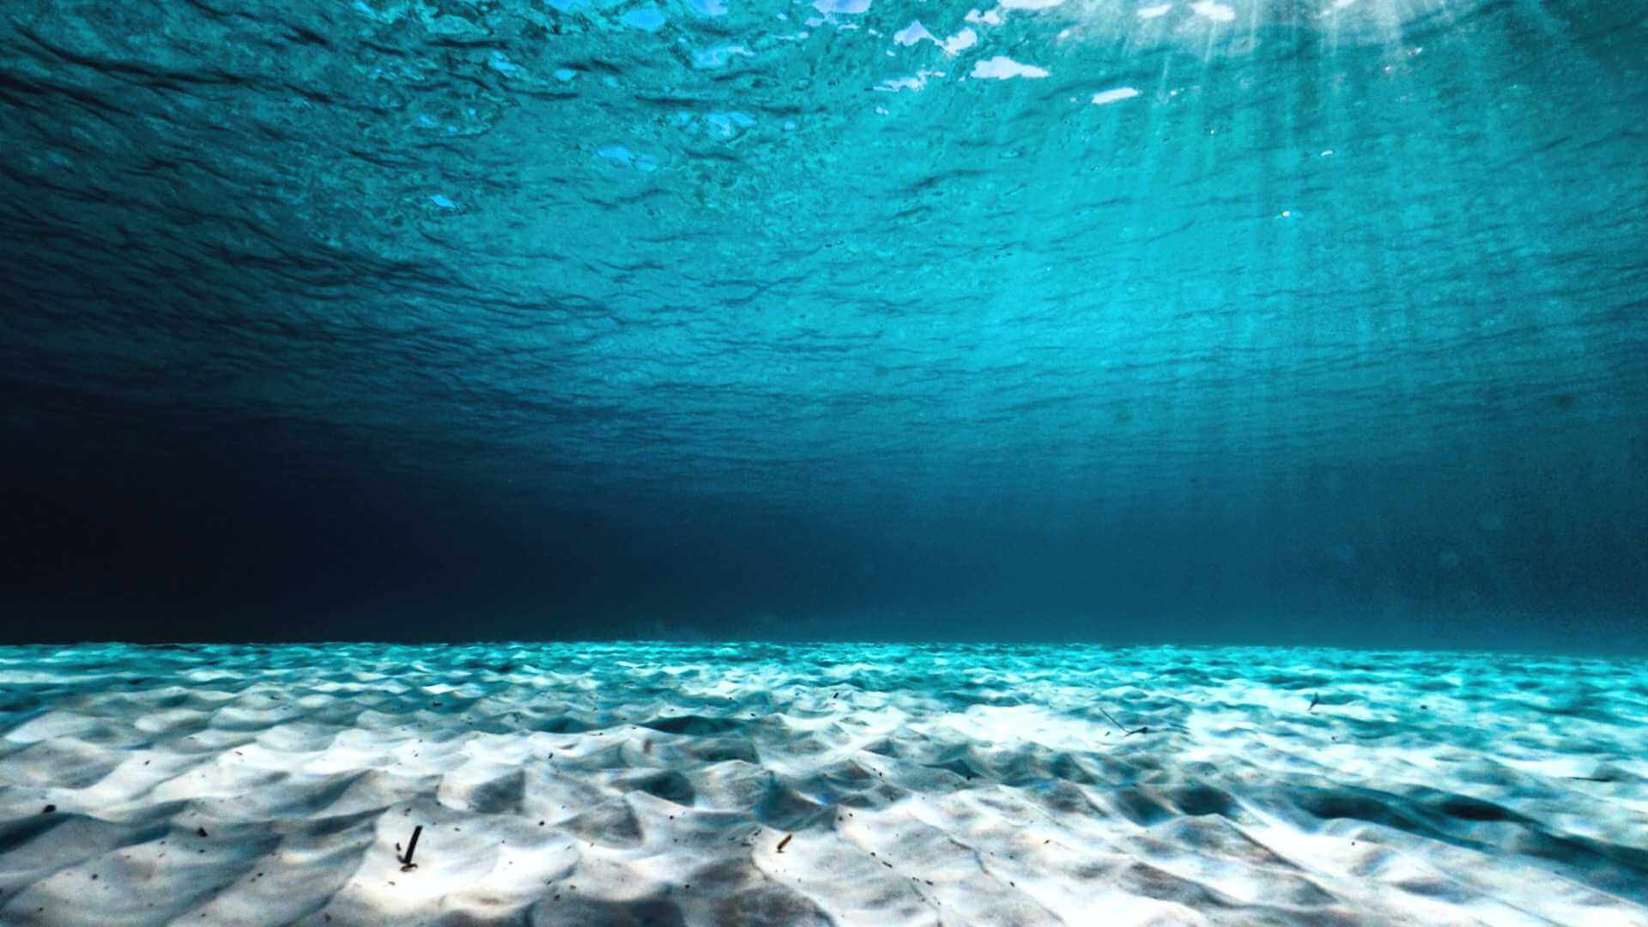
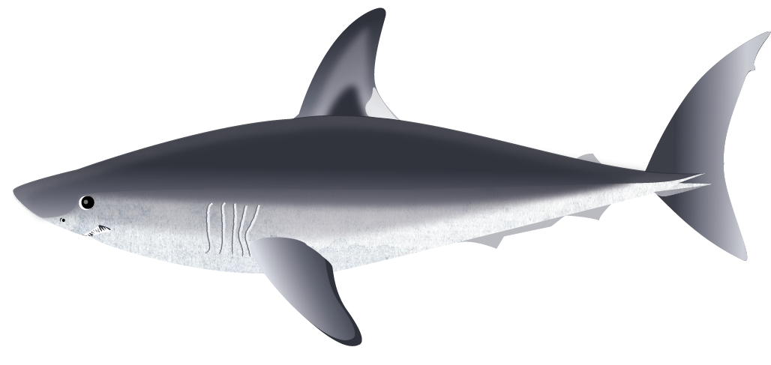
Shark Ecology & Threats Quiz
Play Quiz!

Slide 2
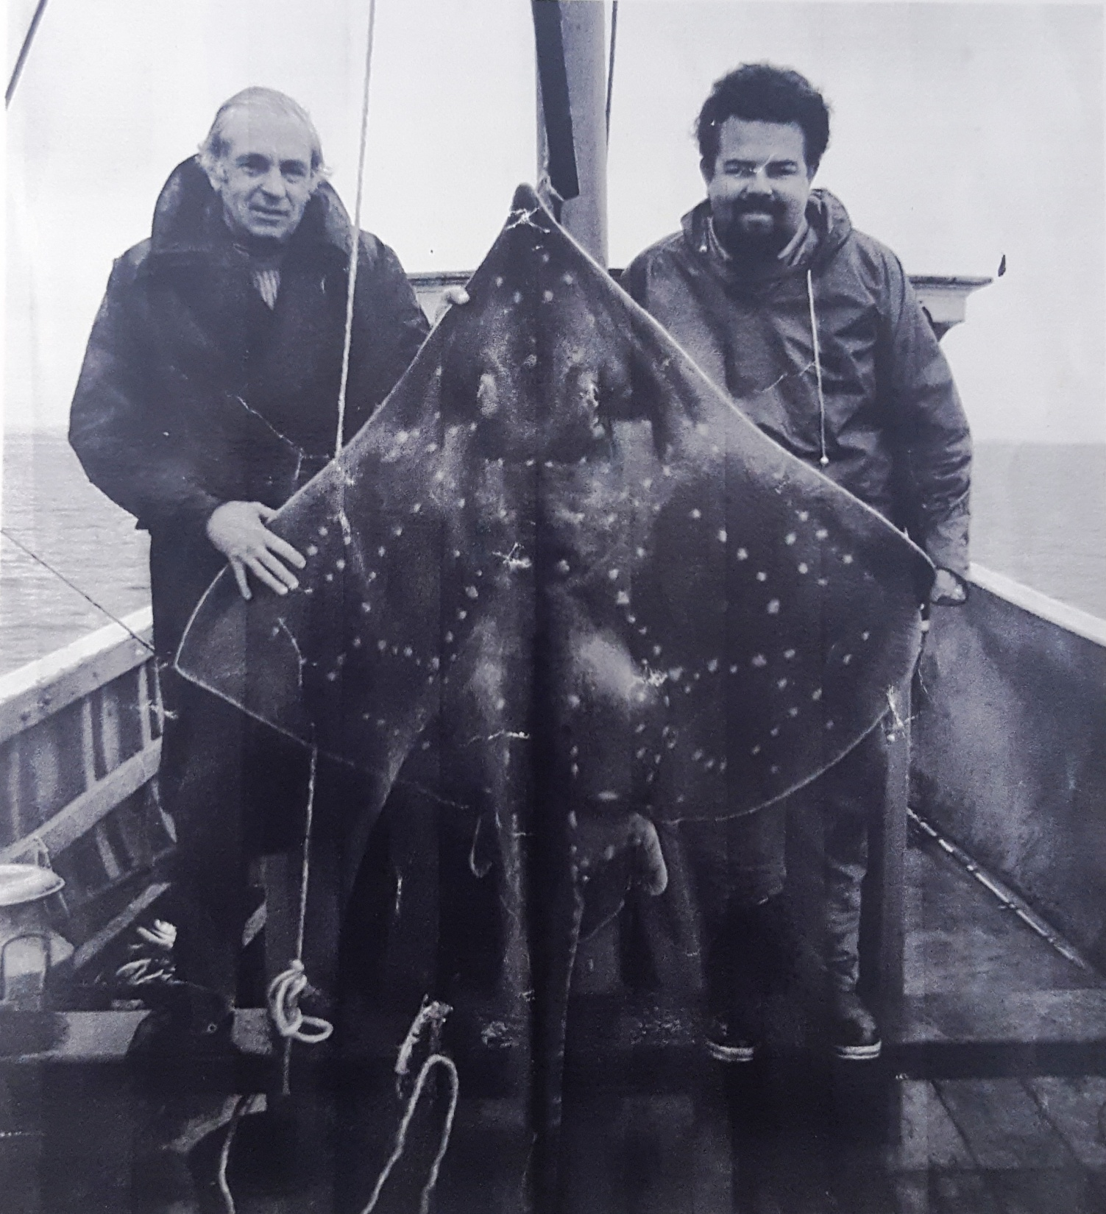
1. How much of all shark populations around the world have we lost?
90%
70%
80%
www.seadeepni.org @seadeepni

Slide 3
Oops… that’s wrong
Although we have lost a lot of shark populations, it hasn’t been quite this much!
Try again
www.seadeepni.org @seadeepni

Slide 4
Oops… that’s wrong
We have actually lost more than you may think!
Try again
www.seadeepni.org @seadeepni

Slide 5
Yes! That’s correct.
Globally there has been a drastic decline in shark numbers. We have lost approximately 80% of all shark populations around the world!
Next question
www.seadeepni.org @seadeepni

Slide 6
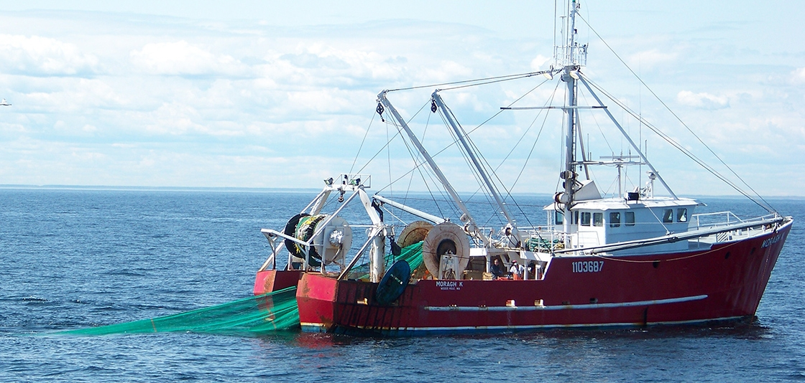
2. Bycatch is when fish are caught accidentally that are the wrong size or are species that are banned or endangered.
TRUE or FALSE
www.seadeepni.org @seadeepni

Slide 7
Yes! That’s correct.
Bycatch occurs when species other than the target species are caught by accident in fishing nets. This includes fish that are too small and banned or endangered species!
Next question
www.seadeepni.org @seadeepni

Slide 8
Oops… that’s wrong
Bycatch occurs when species other than the target species are caught by accident in fishing nets. This includes fish that are too small and banned or endangered species!
Next question
www.seadeepni.org @seadeepni

Slide 9
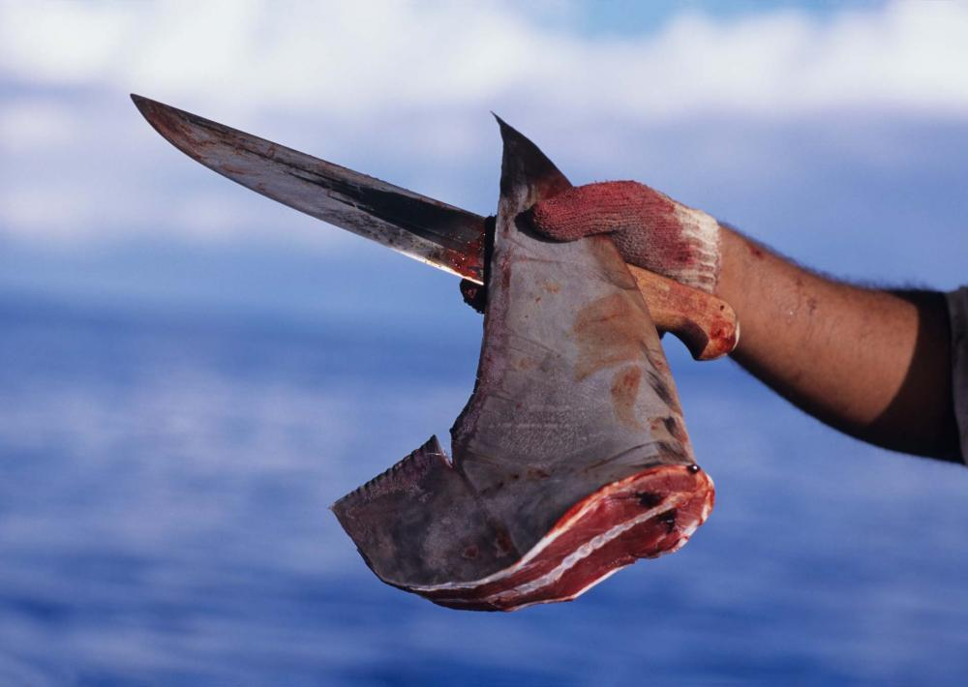
3. What part of a shark is very expensive and sold to make soup?
Tail
Fins
Teeth
www.seadeepni.org @seadeepni

Slide 10
Oops… that’s wrong
Shark tails are not used for soup! Sharks use their tails to steer them through the water.
Try again
www.seadeepni.org @seadeepni

Slide 11
Yes! That’s correct
Finning has been a huge problem for sharks! Fins are extremely valuable in an expensive Asian banquet dish called fin soup.
Next question
www.seadeepni.org @seadeepni

Slide 12
Oops… that’s wrong
Shark teeth aren’t used in soup but did you know that if a shark’s tooth falls out, it can be replaced by one from it’s many rows of backup teeth!
Try again
www.seadeepni.org @seadeepni

Slide 13
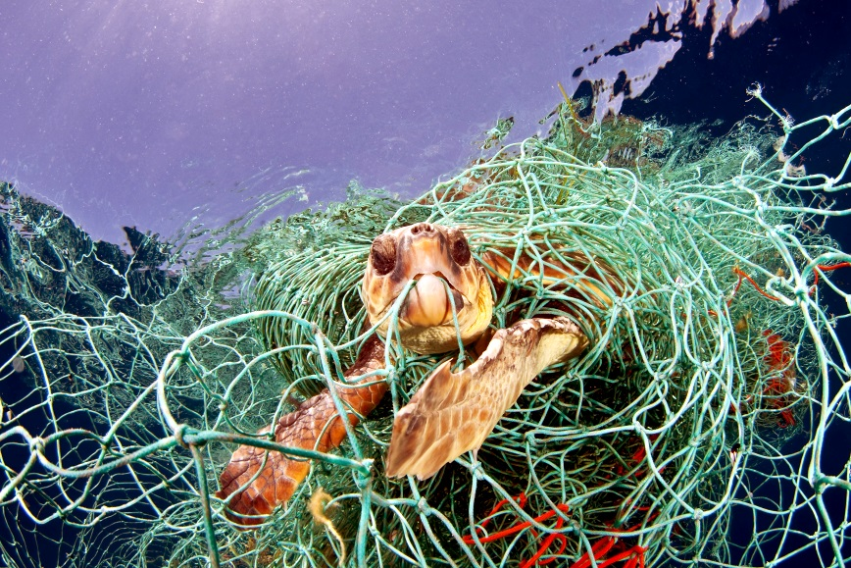
4. Discarded fishing gear and nets can also be known as phantom nets.
TRUE or FALSE
www.seadeepni.org @seadeepni

Slide 14
Oops… that’s wrong
They are called ghost nets because they just float around the ocean waiting to capture and kill everything in its path. They can do this for centuries after they enter the ocean!
Next question
www.seadeepni.org @seadeepni

Slide 15
Yes! That’s correct.
They are called ghost nets because they just float around the ocean waiting to capture and kill everything in its path. They can do this for centuries after they enter the ocean!
Next question
www.seadeepni.org @seadeepni

Slide 16
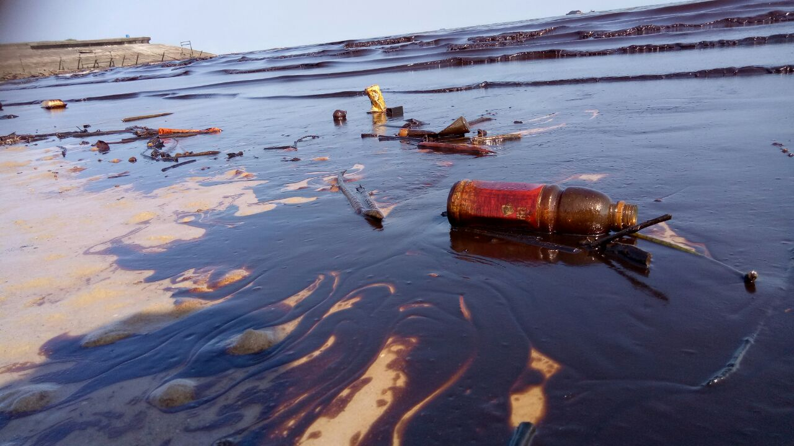
5. Which of the following are types of pollution?
Plastic
Oil spills
Run off
All of the above
www.seadeepni.org @seadeepni

Slide 17
Oops… That’s wrong – Sort of!
Plastic, oil spills and run off are all types of pollution that have different effects on sharks! Plastic can cause entanglement and oil spills and run off can be toxic and cause dead zones!
Next question
www.seadeepni.org @seadeepni

Slide 18
Yes! That’s correct
Plastic, oil spills and run off are all types of pollution that have different effects on sharks! Plastic can cause entanglement and oil spills and run off can be toxic and cause dead zones!
Next question
www.seadeepni.org @seadeepni

Slide 19
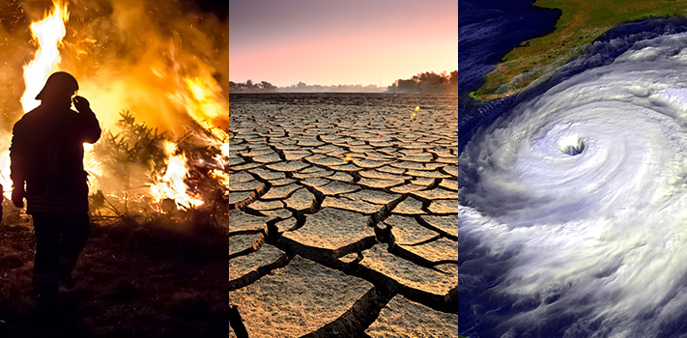
6. Climate change is another threat to sharks.
TRUE or FALSE
www.seadeepni.org @seadeepni

Slide 20
Yes! That’s correct
The changes in ocean temperature could mean sharks have to travel elsewhere to survive and ocean acidification could affect their scales, affecting their ability to swim!
Next question
www.seadeepni.org @seadeepni

Slide 21
Oops… That’s wrong
The changes in ocean temperature could mean sharks have to travel elsewhere to survive and ocean acidification could affect their scales, affecting their ability to swim!
Next question
www.seadeepni.org @seadeepni

Slide 22
7. Why are sharks particularly at risk?
They are slow growing
They take resting years
They have home sites
All of the above
www.seadeepni.org @seadeepni

Slide 23
Oops… That’s wrong – Sort of!
Sharks are slow growing, have resting years and tend to stay in home sites! All of these traits make them vulnerable and particularly at risk to thinks such as climate change, pollution and overfishing!
Next question
www.seadeepni.org @seadeepni

Slide 24
Yes! That’s correct.
Sharks are slow growing, have resting years and tend to stay in home sites! All of these traits make them vulnerable and particularly at risk to thinks such as climate change, pollution and overfishing!
Next question
www.seadeepni.org @seadeepni

Slide 25
8. What does the IUCN Red List measure?
The pressure acting on species, guiding actions to prevent extinction
The number of species that are extinct
www.seadeepni.org @seadeepni

Slide 26
Yes! That’s correct
The IUCN Red List measures the pressures acting on species like climate change and overfishing. This helps to guide conservation actions to help prevent extinctions! The further down the scale, the greater the extinction.
Next question
www.seadeepni.org @seadeepni

Slide 27
Oops… That’s wrong
The IUCN Red List measures the pressures acting on species like climate change and overfishing. This helps to guide conservation actions to help prevent extinctions! The further down the scale, the greater the extinction.
Next question
www.seadeepni.org @seadeepni

Slide 28
9. Extinction means there are no living individuals left anywhere in the world!
TRUE or FALSE
www.seadeepni.org @seadeepni

Slide 29
Yes! That’s correct
Extinction means there are no living individuals left anywhere in the world (so none in the wild or captivity). The animal is gone forever!
Next question
www.seadeepni.org @seadeepni

Slide 30
Oops… that’s wrong
Extinction means there are no living individuals left anywhere in the world (so none in the wild or captivity). The animal is gone forever!
Next question
www.seadeepni.org @seadeepni

Slide 31
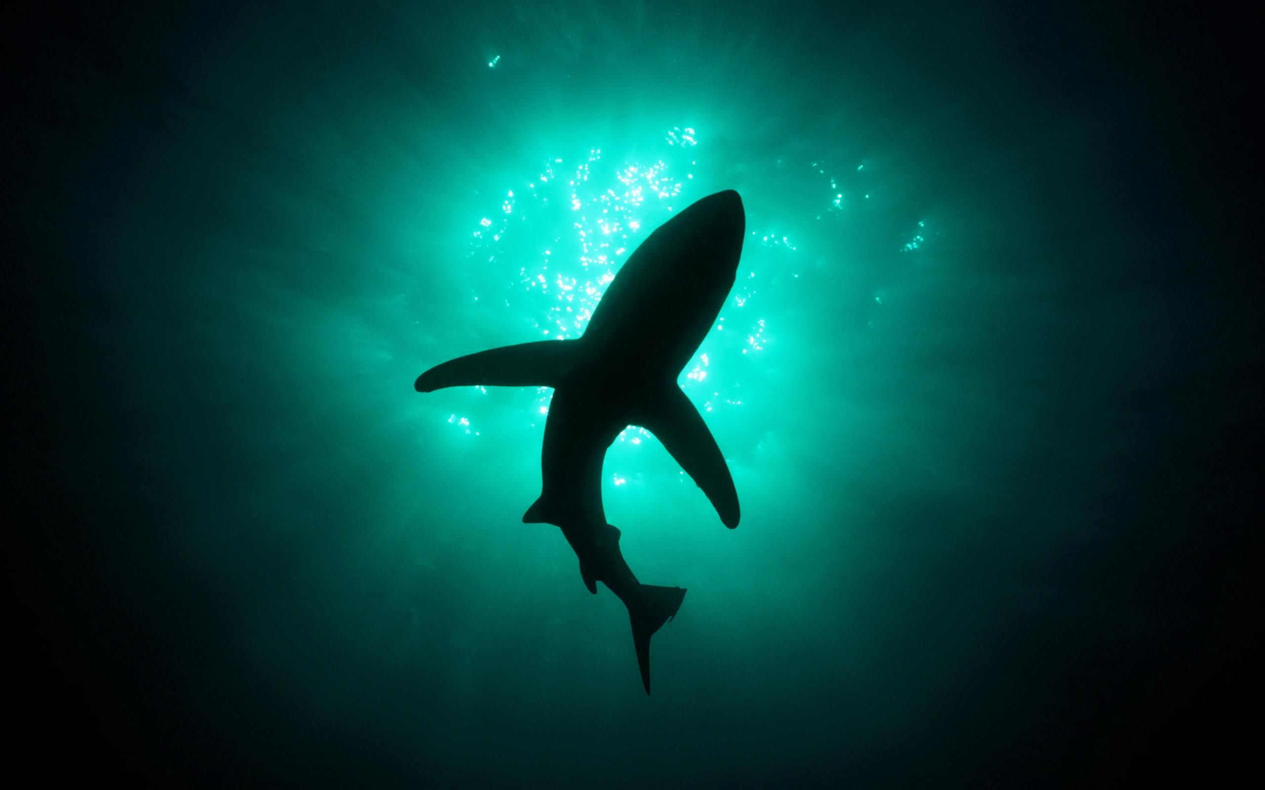
WELL DONE!
In Deep Water Quiz

