Slide 1
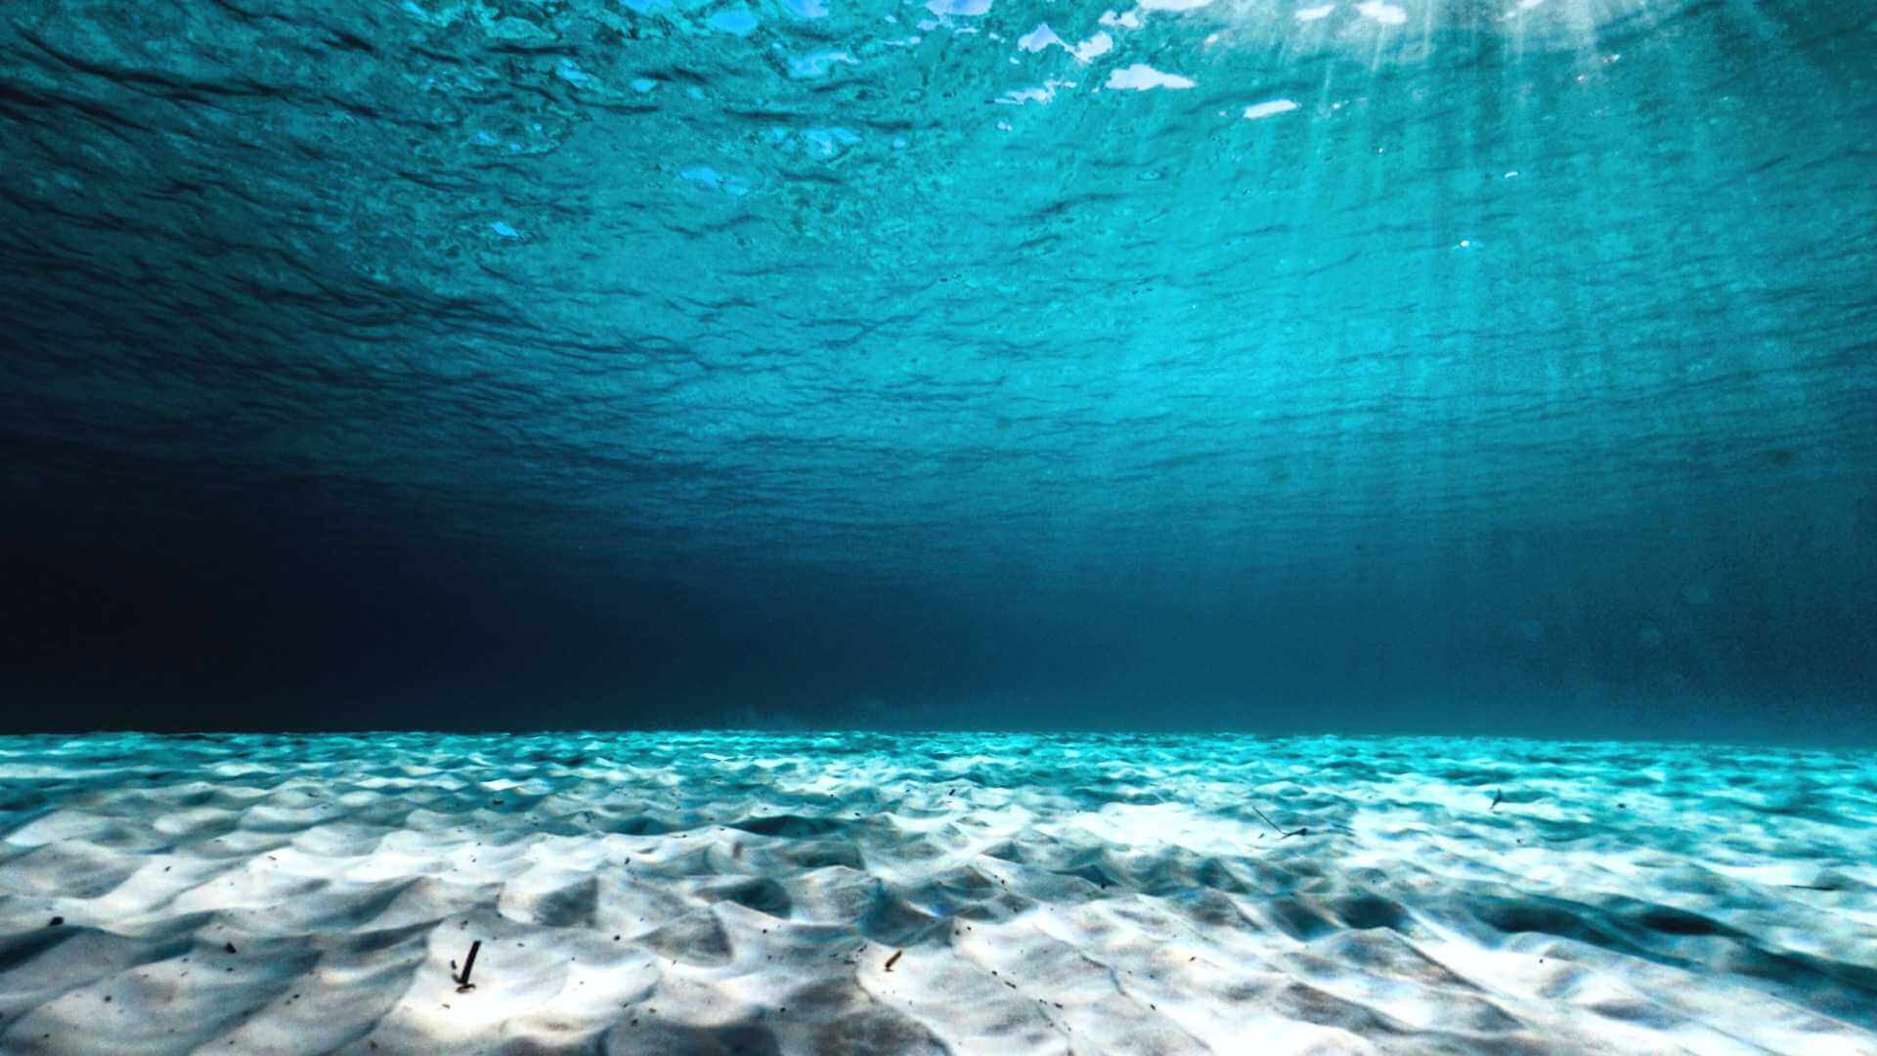
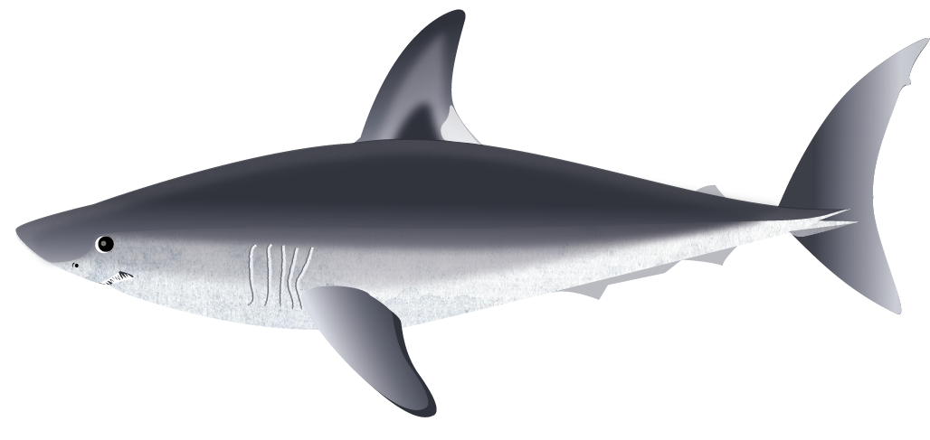
Shark Biology Quiz
Let’s recap everything you learnt in lesson 1 What makes a shark a shark?
Play Quiz!

Slide 2
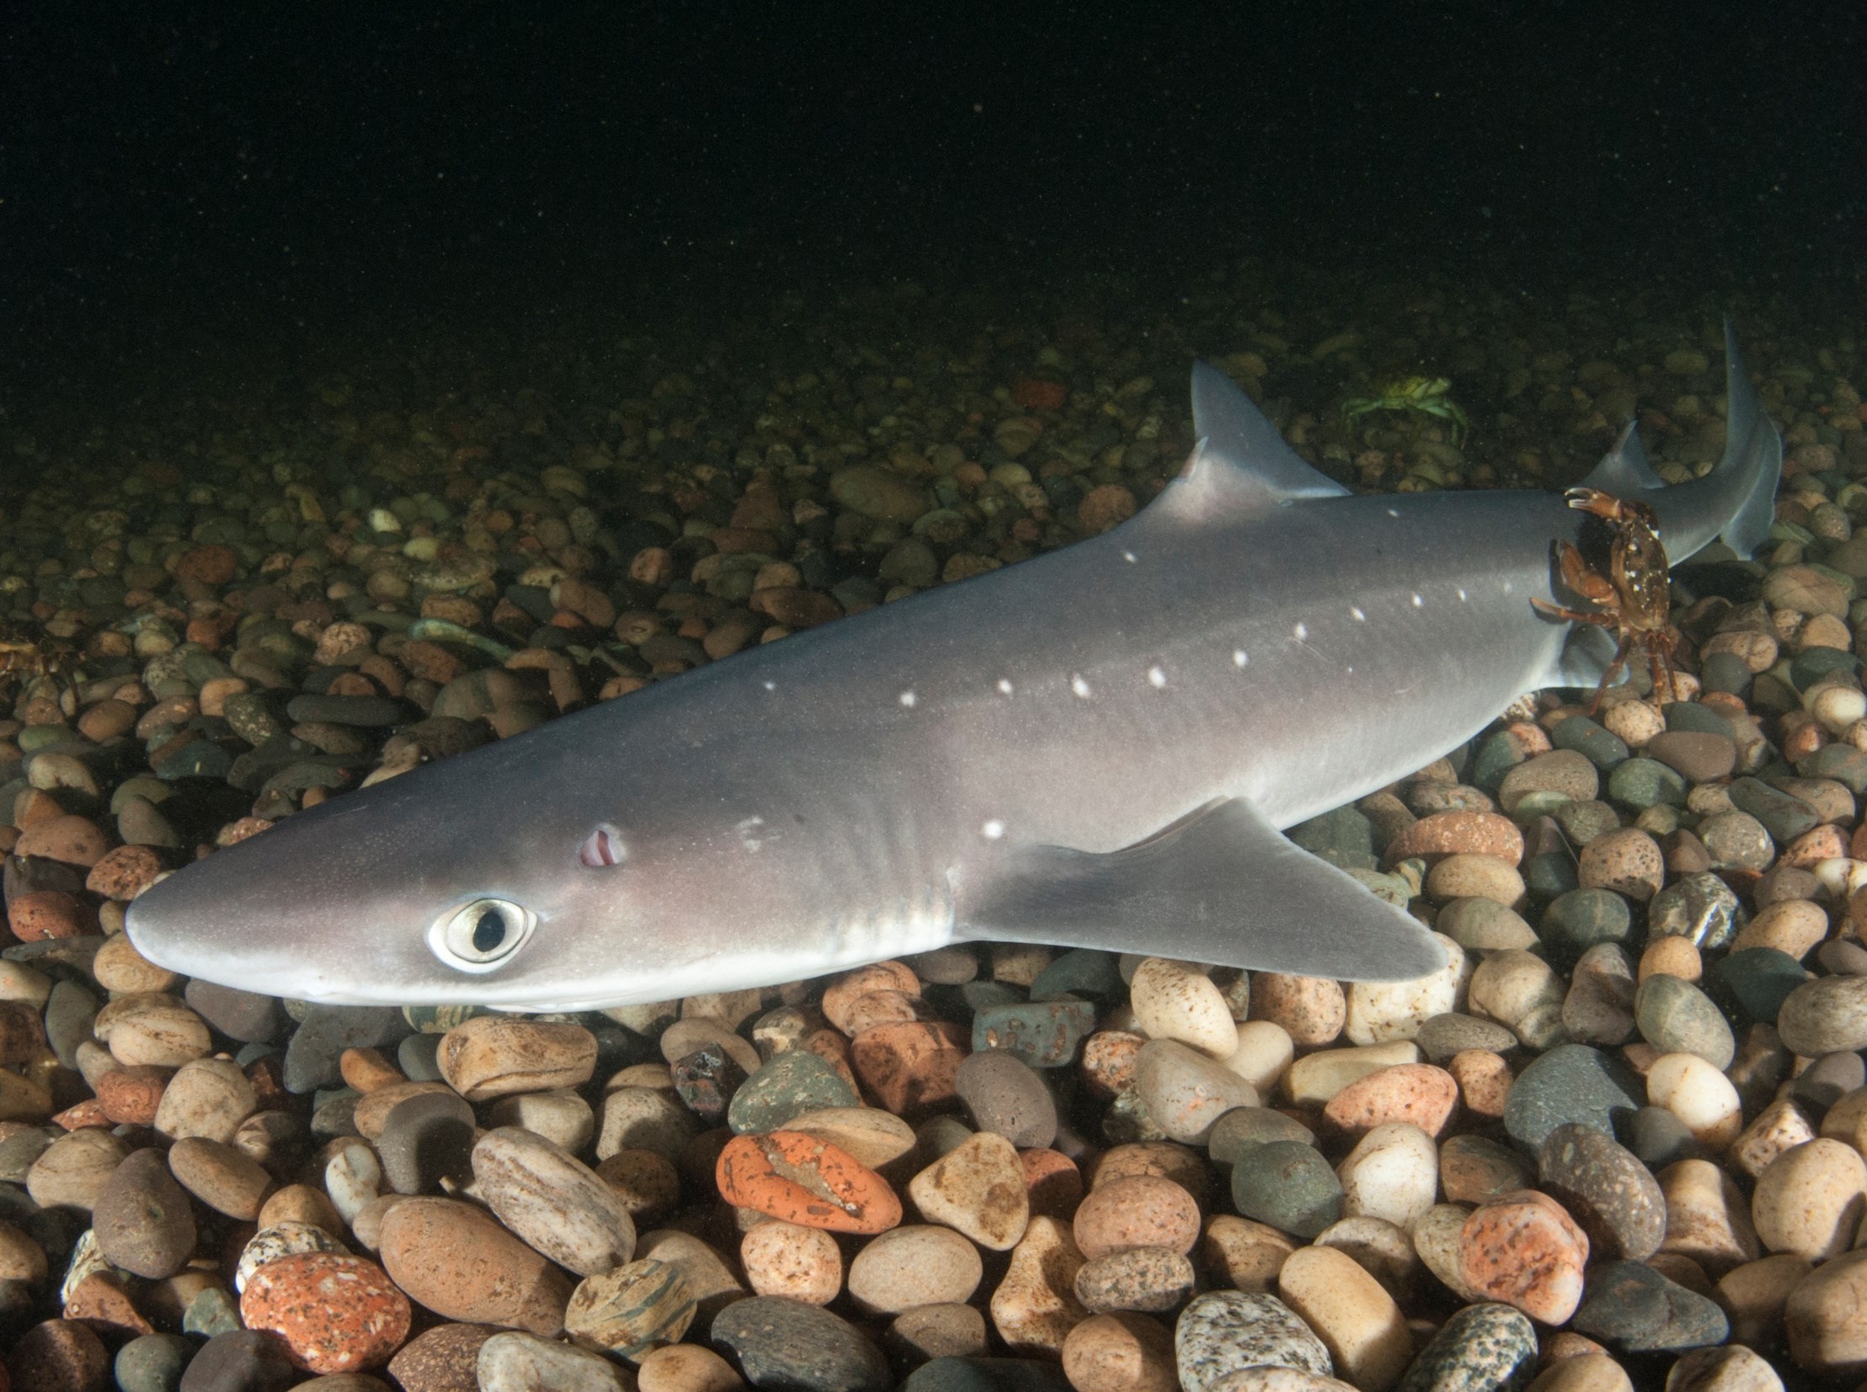
1. What is the scientific name for the group of animals, sharks, skates and rays?
Elasmobranchs
Predators
Bony fish
www.seadeepni.org @seadeepni

Slide 3
Yes! That’s correct.
Elasmobranchs are a closely related group of animals made up of sharks, skates and rays.
Next question
www.seadeepni.org @seadeepni

Slide 4
Opps… that’s wrong
Predators are animals that naturally prey on others. This is not a taxonomic classification.
Try again
www.seadeepni.org @seadeepni

Slide 5
Opps… that’s wrong
Bony fish are called Teleosts. This group includes fish like mackeral, herring, tuna and clown fish.
Try again
www.seadeepni.org @seadeepni

Slide 6
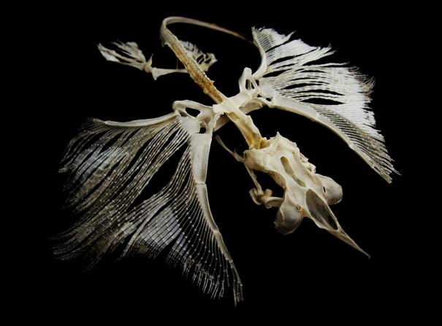
2. The skeleton of a shark is made from a material called cartilage.
TRUE or FALSE
www.seadeepni.org @seadeepni

Slide 7
Yes! That’s correct.
The skeleton of sharks, skates and rays is made of cartilage. This is a flexible material that enables them to make quick turns in the water. It is also lighter than bone.
Next question
www.seadeepni.org @seadeepni

Slide 8
Opps… that’s wrong
The skeleton of sharks, skates and rays is made of cartilage. This is a flexible material that enables them to make quick turns in the water. It is also lighter than bone.
Next question
www.seadeepni.org @seadeepni

Slide 9
3. What is the skin of sharks made up of?
Fish scales
Cartilage
Denticles
www.seadeepni.org @seadeepni

Slide 10
Opps… that’s wrong
Bony fish have scales covering their body
Try again
www.seadeepni.org @seadeepni

Slide 11
Opps… that’s wrong
Cartilage is the material shark skeletons is made from.
Try again
www.seadeepni.org @seadeepni

Slide 12
Yes! That’s correct
Shark skin is made up of tiny armored plates called denticles. These protect the shark from parasites. They are a hydrodynamic shape to help sharks swim efficiently.
Next question
www.seadeepni.org @seadeepni

Slide 13
4. How do sharks control their buoyancy?
Swim bladder
Large oily liver
Lateral line
www.seadeepni.org @seadeepni

Slide 14
Opps… that’s wrong
Bony fish use swim bladders to control their buoyancy.
Sharks do not have swim bladders.
Try again
www.seadeepni.org @seadeepni

Slide 15
Opps… that’s wrong
The lateral line is used to detect changes in water pressure and movement.
Try again
www.seadeepni.org @seadeepni

Slide 16
Yes! That’s correct.
Sharks have large oily livers that help them to maintain buoyancy in the water. Some sharks like the Basking shark have liver so large it takes up one third of their body weight!
Next question
www.seadeepni.org @seadeepni

Slide 17
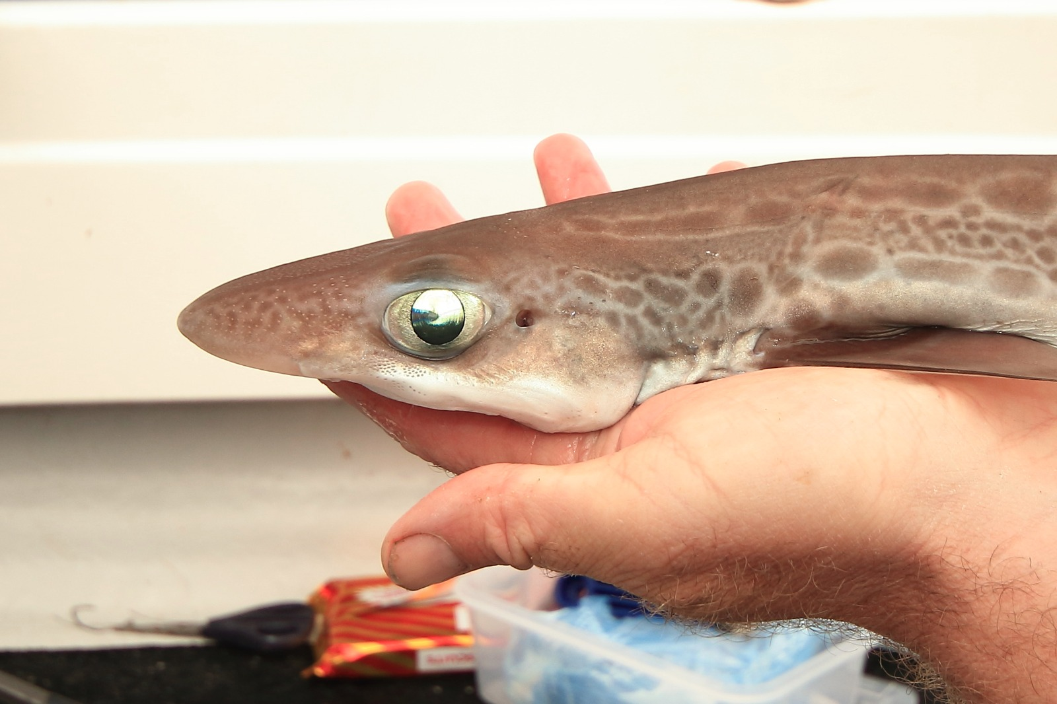
5. Tapetum lucidum help sharks to see in low light conditions.
TRUE or FALSE
www.seadeepni.org @seadeepni

Slide 18
Yes! That’s correct.
The Tapetum Lucidum is a layer of reflective cells that helps sharks to see in low light conditions. This is important as light does not travel far in water.
Next question
www.seadeepni.org @seadeepni

Slide 19
Opps… That’s wrong
The Tapetum Lucidum is a layer of reflective cells that helps sharks to see in low light conditions. This is important as light does not travel far in water.
Next question
www.seadeepni.org @seadeepni

Slide 20
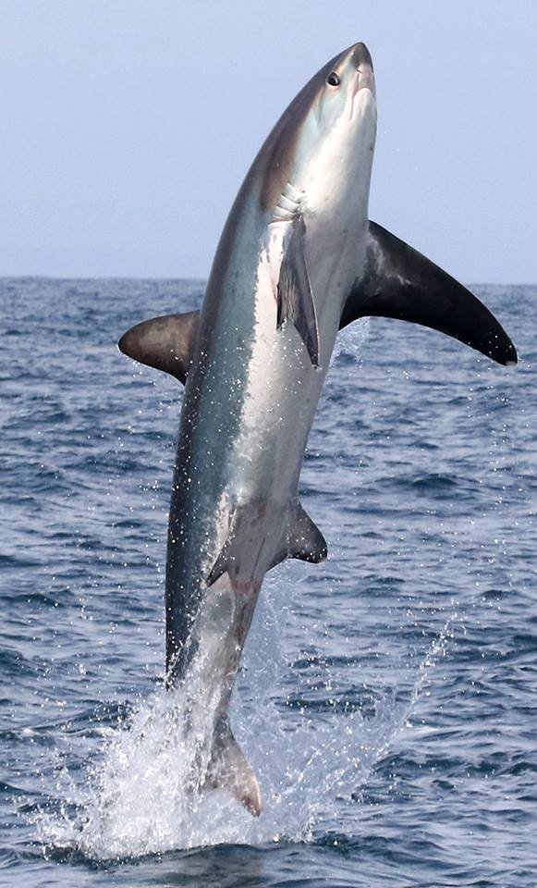
6. What do sharks use to examine unfamiliar objects in the water?
Teeth
Hands
Fins
Eyes
www.seadeepni.org @seadeepni

Slide 21
Opps… That’s wrong
Sharks don’t have hands!
Try again
www.seadeepni.org @seadeepni

Slide 22
Opps… That’s wrong
Fins provide balance and stability in the water.
Try again
www.seadeepni.org @seadeepni

Slide 23
Opps… That’s wrong
Sharks use their eyes to see what is around them.
Try again
www.seadeepni.org @seadeepni

Slide 24
Yes! That’s correct.
Sharks are curious creatures and use their teeth to take ‘test bites’. This allows them to learn more about the object.
Next question
www.seadeepni.org @seadeepni

Slide 25
7. Which organ allows sharks and rays to breathe when lying on the seafloor?
Gills
Spiracle
Nictating membrane
www.seadeepni.org @seadeepni

Slide 26
Opps… That’s wrong
Gills allow sharks and skates to breathe underwater but sometimes they are buried in the sand.
Try again
www.seadeepni.org @seadeepni

Slide 27
Opps… That’s wrong
A nictating membrane is a protective third eyelid that some species of sharks have
Try again
www.seadeepni.org @seadeepni

Slide 28
Yes! That’s correct.
Spiracles are a secondary way for sharks and skates to breathe whenever their gills are buried in the sand
Next question
www.seadeepni.org @seadeepni

Slide 29
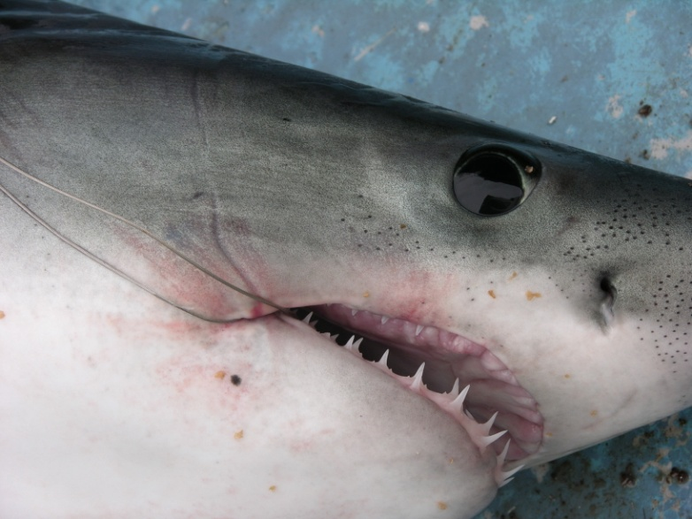
8. What does the Ampullae of Lorenzini do?
Sense electrical currents
Help sharks migrate long distances
Help sharks detect prey
All of the above
www.seadeepni.org @seadeepni

Slide 30
Opps… That’s wrong - Sort of!
The Ampullae of Lorenzini detect electrical signals such as electromagnetic fields around the earth, and the heartbeat of prey, helping them ti migreate and find prey.
Next question
www.seadeepni.org @seadeepni

Slide 31
Yes! That’s correct.
The Ampullae of Lorenzini detect electrical signals such as electromagnetic fields around the earth, and the heartbeat of prey, helping them ti migreate and find prey.
Next question
www.seadeepni.org @seadeepni

Slide 32
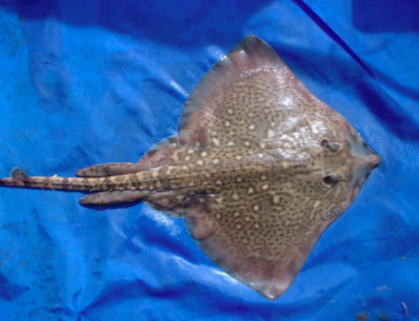
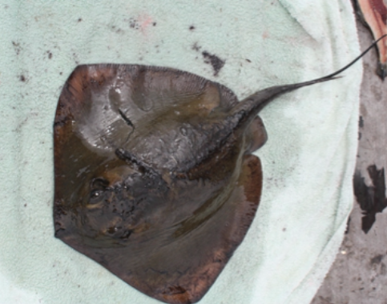
9. Which of these is NOT a difference between skates and rays?
The shape of their tail
How they reproduce
Their teeth
The material of their skeleton
www.seadeepni.org @seadeepni

Slide 33
Opps… that’s wrong
Skates have a robust tail with
dorsal fins.
Rays have a whip-like tail with spines.
Try again
www.seadeepni.org @seadeepni

Slide 34
Opps… that’s wrong
Skates lay eggs to reproduce.
Rays give birth to live young.
Try again
www.seadeepni.org @seadeepni

Slide 35
Opps… that’s wrong
Skates have crushing plates to feed on shelled prey.
Rays have sharp teeth.
Try again
www.seadeepni.org @seadeepni

Slide 36
Yes! That’s correct.
Both skates and rays have cartilage skeletons.
Next question
www.seadeepni.org @seadeepni

Slide 37
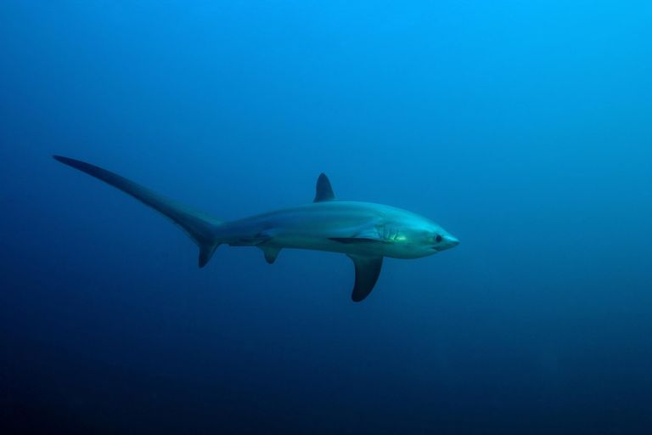
10. Are there sharks in Northern Ireland?
No way!
Yes, we have the coolest sharks In our waters!
www.seadeepni.org @seadeepni

Slide 38
Yes! That’s correct
Meet our local sharks in the next lesson!
End Quiz
www.seadeepni.org @seadeepni

Slide 39
Opps… That’s wrong
Meet our local sharks in the next lesson!
End Quiz
www.seadeepni.org @seadeepni

Slide 40
WELL DONE!
Shark Biology Quiz

